Slide 1
CPIN
Central PA IP Network

Slide 2
Purpose
A network providing high speed multi- media fixed and portable communications during times of disaster
Capabilities include voice, data and HD video

Slide 3
Founders
Several amateur radio operators built this network in central Pennsylvania using their own funds and resources.
Multiple contributors were solicited to provide the necessary high profile microwave sites.

Slide 4
Needed Communications
Ask your emergency management coordinators what gaps exist in their emergency communications systems and plans.
In Central Pennsylvania we asked that question and received these answers:
POTS telephone service separate from the PSTN
FAX machine communications separate from the PSTN
Backup communication between the County EOC and local townships

Slide 5
Telephone & FAX
Under Part 15 anyone may use
Under Part 97 anyone may use in a disaster
24/7 amateur manpower is finite
Easily operated by all
Real telephone service, not simplex
Private system with public gateways
Easy to add where needed
Email adds an extra step of complexity

Slide 6
Network Backbone
13 High-profile relay sites
157 Miles of network backbone w/ 65 transmitters
25 Subscribers connected
Majority is privately owned
93 Mbps maximum throughput
150 Mbps maximum aggregate throughput
Cisco Routers and Switches throughout the network
VLAN topology deployed
Ubiquity Networks equipment used throughout

Slide 7
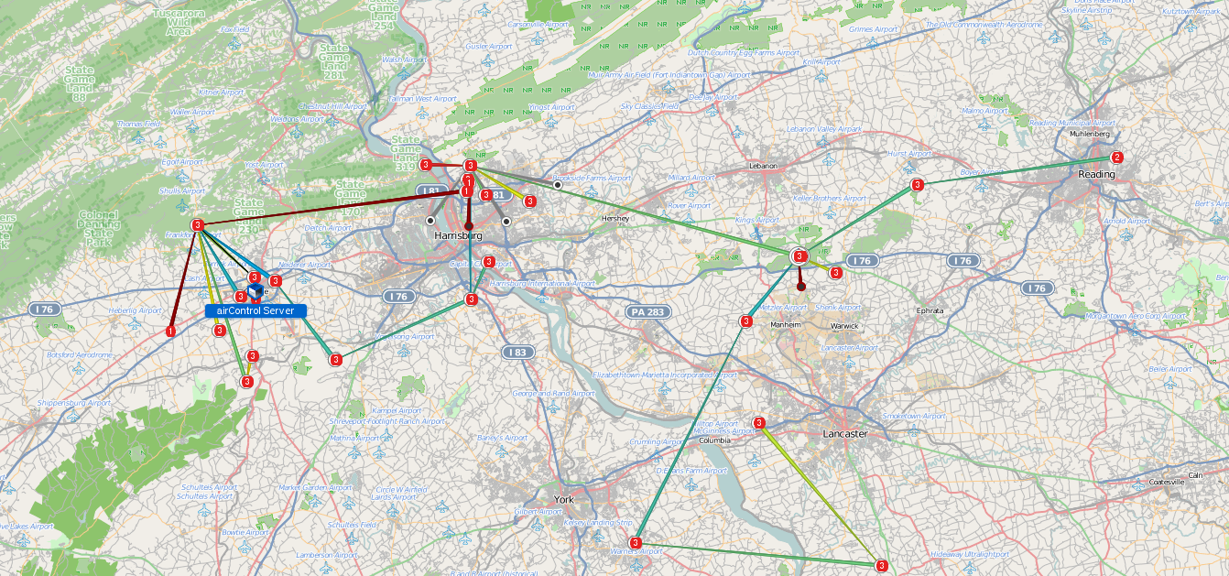
CPIN Network Map

Slide 8
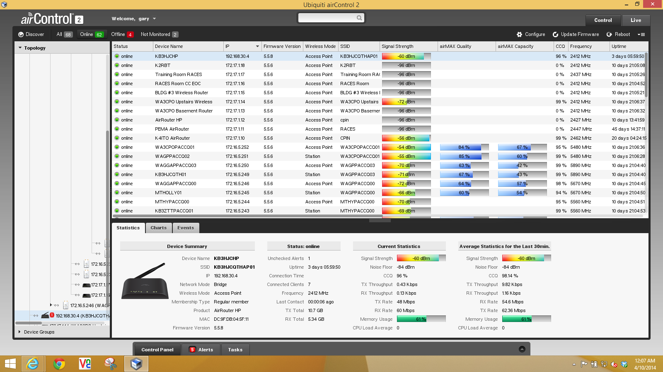

Slide 9
Primarily 5 GHz Band
5.150-5.250 Part 15 low power indoor
5.250-5.350 Part 15 low power
5.475-5.600 Part 15 low power
5.600-5.650 No Operation: Airport Radar
5.650-5.725 Part 15 low power
5.725-5.875 Part 15 high power
5.650-5.925 Part 97 full power
5.250-5.600 Proposed Part 15 low power
5.725-5.925 Proposed Part 15 high power

Slide 10
Network Utilization
Asterisk IP Telephony w/gateways to public network & remote repeater access
Asterisk IP Fax
20 IP Cameras
File server/shared drive access
Multiple Emergency Internet Gateways
Amateur Repeater Interconnections
Railfan Signal and Audio

Slide 11
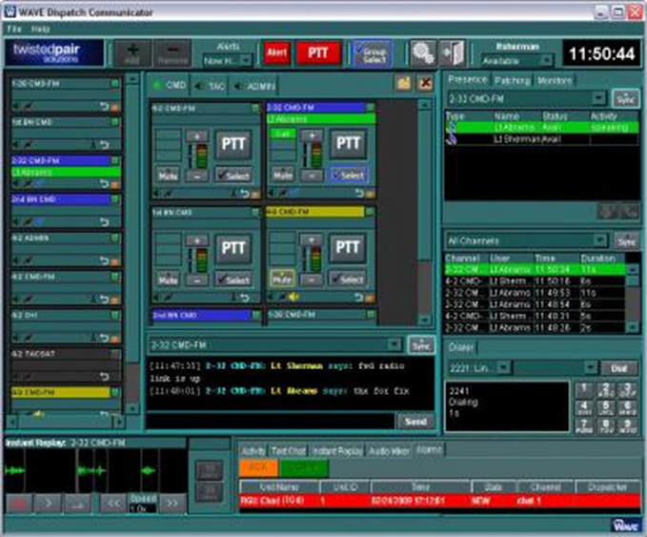
Dispatch Communicator provides a rich and powerful VoIP Dispatch console for today’s critical communications environments
Multiple radio channels, telephone calls and other communications systems can be patched together with just a few clicks

Slide 12
Users
PEMA HQ
Cumberland County RACES (ACS) at EOC
Lancaster County RACES (ACS) at EOC
More RACES (ACS) at EOCs to be added
Ethernet connection to each county EOC via Task Force Microwave: under construction
Individual Radio Amateurs

Slide 13
Potential Users
Red Cross
Salvation Army
Emergency Relocation Shelters
Other Volunteer Organizations Active in Disasters (VOAD)

Slide 14
RF ACCESS POINTS
Cumberland County: Waggoner’s Gap
White Rock
Lam’s Gap: Under construction
Three Square Hollow: Future
Dauphin County: Reeser’s Summit
Blue Mountain
Lebanon County: Cornwall Mountain
Lancaster County: Cornwall Mountain
Lancaster City: Future

Slide 15
FUTURE RF ACCESS POINTS
York County
Adams County
Franklin County
Perry County

Slide 16
RF ACCESS POINT RANGE
Nanostation M5 15 dBi gain antenna: 3 miles
Nanobridge M5 25 dBi gain antenna: 7 miles
Rocket Dish 24” 30 dBi gain antenna: 13 miles
All devices use Horizontal & Vertical polarities simultaneously
300 Mbps on a simplex frequency
Current transmitter ethernet port limits throughput to 100 Mbps
Maximum throughput 150 Mbps aggregate (both directions)
Planned upgrade has 1000 Mbps ethernet ports

Slide 17
Annual Field Day Testing
Simulates disaster communication in a portable environment
Provides POTS telephone circuits to emergency centers
Provides POTS access to PSTN
Provides FAX service to emergency centers & public network
Provides multiple internet gateways
Provides on-site IP camera & viewing of other IP cameras on network
All of these services provided on a single RF frequency

Slide 18
Daily Testing of Circuits
Network online for over four years
Established links have very high reliability
Management software alerts any circuit or element failure
Ubiquity equipment is inexpensive & reliable
Multiple hams participate in system maintenance

Slide 19
Searching for Other Users
Every transmitter has built-in tools to search for other users
Site Survey: Searches all used frequencies based on SSID
Spectrum Analyzer: Finds all signals
Reports signal strength and bandwidth

Slide 20
Bridge Mode
All transmitters operate in Bridge Mode, not repeat or router mode
Typical throughput loss in the repeater mode is 50%
Bridge Mode allows higher throughput
For instance inputting 93 Mbps into the first transmitter in series will yield 93 Mbps out of the third transmitter if all are in the Bridge Mode.

Slide 21
Commercial Switches
Cisco 2950 24 port commercial switches are deployed
All network elements are remotely manageable
VLANs may be used to segregate traffic
Some consumer grade routers limit speed to 25 Mbps and have a high failure rate
EBay has switches for about $20 each
PA State Surplus has had them for less
A high quality switch between transmitters is essential for reliable network throughput and stability

Slide 22
Microwave Path Analysis
Use Google Earth or similar to obtain site coordinates
http://n9zia.ampr.org/path.main.cgi
http://community.ubnt.com/t5/airMAX-Getting-Started/airMAX-Plan-a-outdoor-wireless-link/ta-p/487689
http://airlink.ubnt.com/

Slide 23
Speedtests
http://www.speedtest.net/
Find a test in your area that produces the same test result every day.
A reliable test is needed to tweek your throughput:

Slide 24
Throughput Tweeks
Adjust the following for maximum throughput:
Frequency
Bandwidth
ACK
Long Range PTP Link Mode (on or off)
AirMax (on or off)
Power level
Firmware

Slide 25
Ubiquity Networks, Inc
www.ubnt.com
http://www.streakwave.com/product-ubiquiti.asp
http://www.microcom.us/browse-by-brand--ubiquiti-networks.html

Slide 26
CPIN Contact Information
Gary L. Blacksmith Jr., WA3CPO
1215 Georgetown Circle
Carlisle, Pa 17013
717-574-0425
WA3CPO@ARRL.NET

